Slide 1

Customer Churn project
By : Remah Ramadan

Slide 2

AGENDA
Project Overview
Project Objectives
Insight
Machine Learning Insight
Business Recommendations
Expected Business Impact

Slide 3

Project Overview
This project focuses on analyzing customer behavior and predicting churn using machine learning techniques.
The goal is to help banks proactively identify customers at risk of leaving and take data-driven retention actions.

Slide 4

Project Objectives
Understand key factors influencing customer churn
Build a predictive machine learning model
Provide an interactive decision-support application
Reduce churn-related financial losses

Slide 5
The Insights

Slide 6

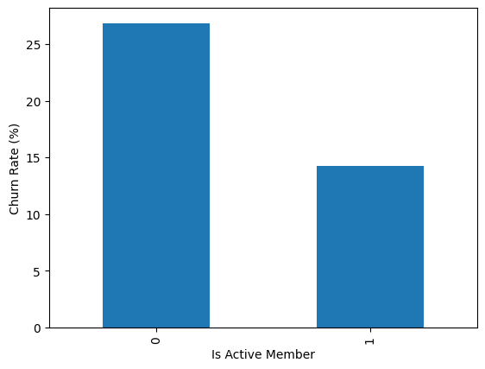
1- Customer Activity Matters Most
Inactive customers show a significantly higher likelihood of churn compared to active customers.

Slide 7
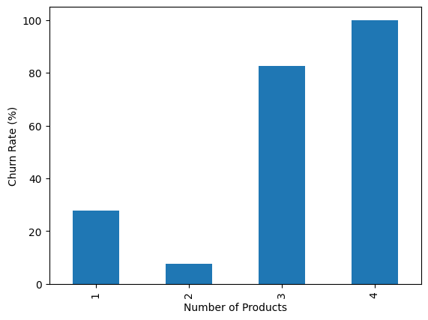
2- Product Engagement Reduces Churn
Customers with multiple banking products are less likely to churn.

Slide 8
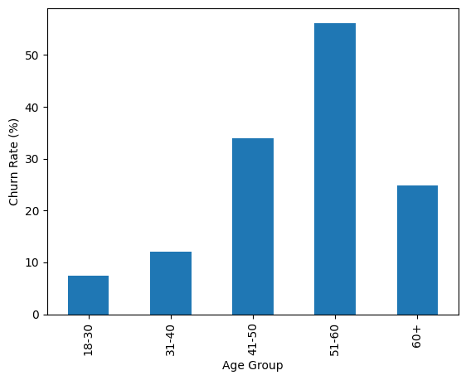
3- Age Plays a Critical Role
Certain age groups show higher churn tendencies, indicating the need for age-specific retention strategies

Slide 9
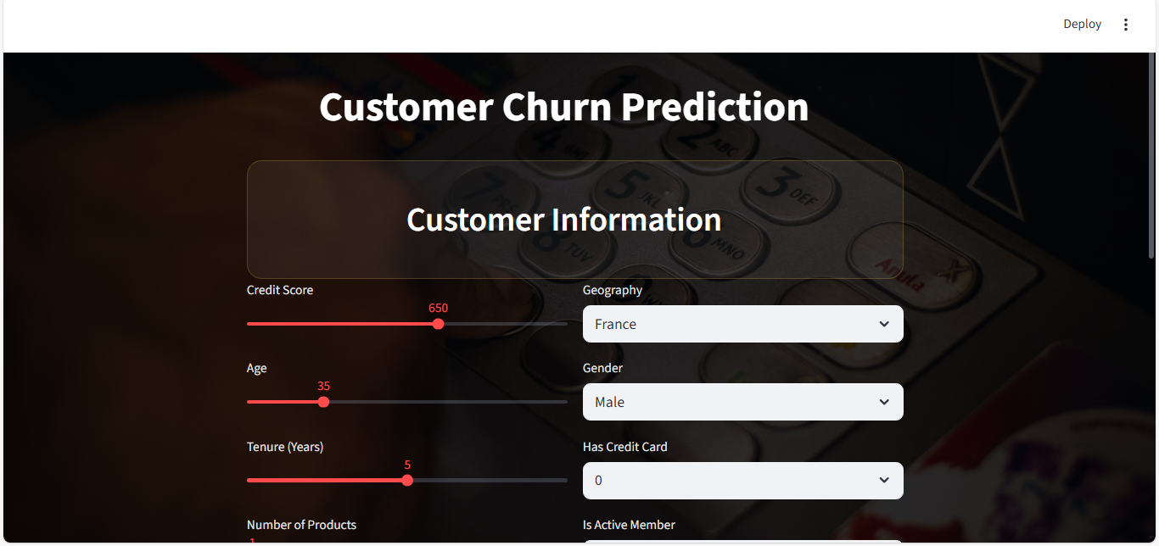
Machine Learning Insight
The machine learning model successfully identifies high-risk customers using behavioral and financial attributes.

Slide 10

Business Recommendations
Launch targeted retention campaigns for inactive customers
Offer personalized product bundles
Monitor high-risk customers in real time
Integrate churn predictions into CRM systems

Slide 11
Expected Business Impact
Reduced customer churn
Improved customer satisfaction
Increased customer lifetime value
Stronger data-driven decision making

Slide 12

THANK YOU
LinkedIn : https://bit.ly/4lDIiPy
GitHub : https://github.com/Remah-data/customer-churn-app
Streamlit app : https://customer-churn-app-m2ov3ycre74zmpxaqye4app.streamlit.app/
Kaggel : https://www.kaggle.com/datasets/remahramadan10/customer-churn

